Slide 1
Artificial Neural Networks
Foundations, Architecture, Mathematics & Applications

Slide 2
AGENDA
What We'll Cover Today
01
02
03
Introduction & Motivation
Biological vs Artificial Neuron
The Perceptron
04
05
06
ANN Architecture
Mathematical Foundation
Activation Functions
07
08
09
Forward Propagation
Hyperparameters, Pros & Cons
Real-World Applications
Artificial Neural Networks
2

Slide 3
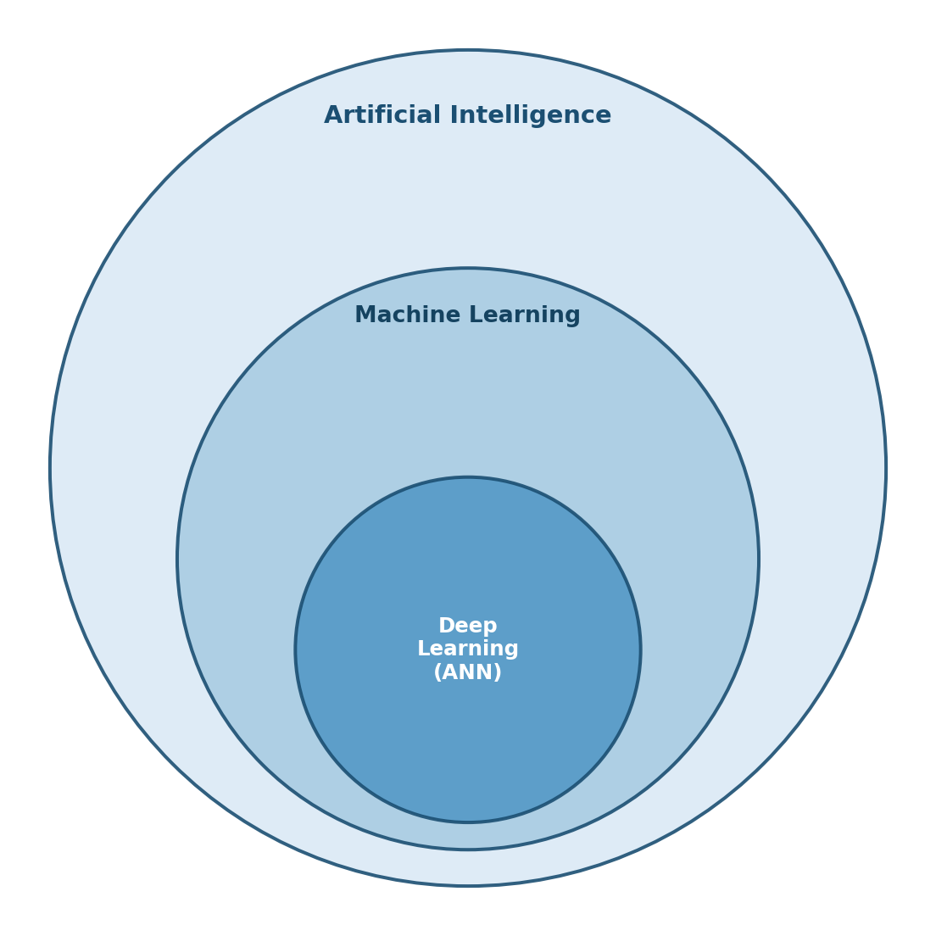
INTRODUCTION
What is Deep Learning & ANN?
Artificial Intelligence: Machines performing tasks that normally require human intelligence. Machine Learning: Systems that learn patterns from data instead of explicit rules. Deep Learning: ML using multi-layer Artificial Neural Networks to learn hierarchical representations.
An ANN learns directly from data — mapping inputs to outputs through layers of weighted, activated connections — rather than following hand-written rules.
Artificial Neural Networks
3

Slide 4
HISTORY
Evolution: Perceptron to Deep Networks
1943
1969
2012
McCulloch–Pitts
neuron model
XOR problem
halts progress
AlexNet & the
Deep Learning boom
Rosenblatt's
Perceptron
1958
Backpropagation
popularized
1986
Deep, large-scale
ANN architectures
Today
Artificial Neural Networks
4

Slide 5
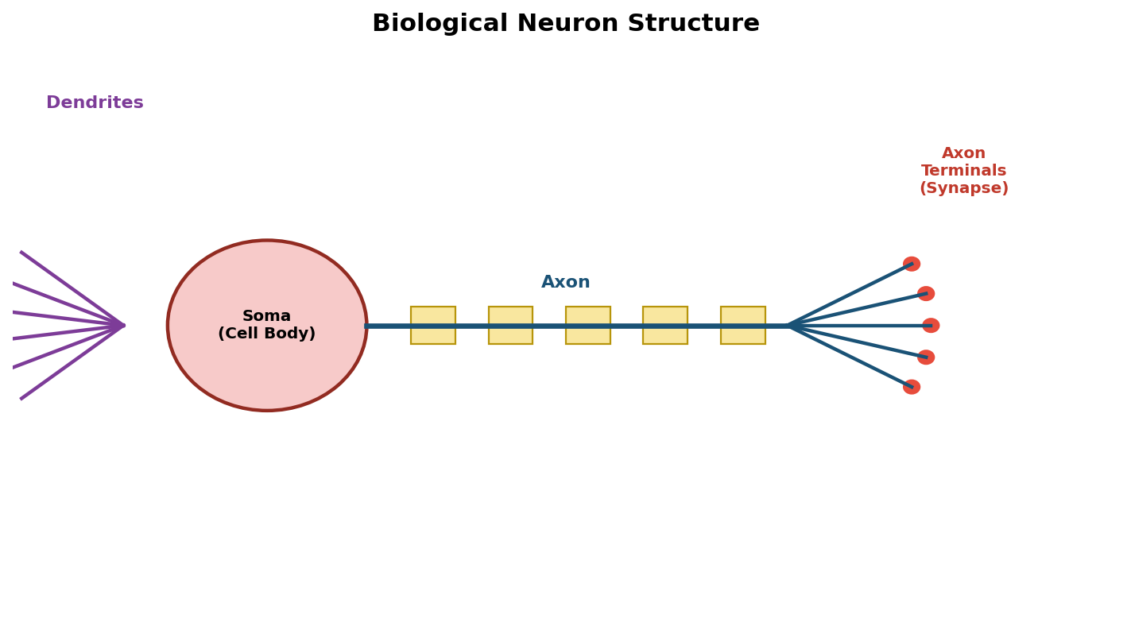
INSPIRATION
The Biological Neuron
Dendrites
Receive electrochemical signals from other neurons
Soma
Integrates incoming signals in the cell body
Axon
Transmits an impulse if the signal exceeds a threshold
Synapse
Junction that passes the signal to the next neuron
Artificial Neural Networks
5

Slide 6
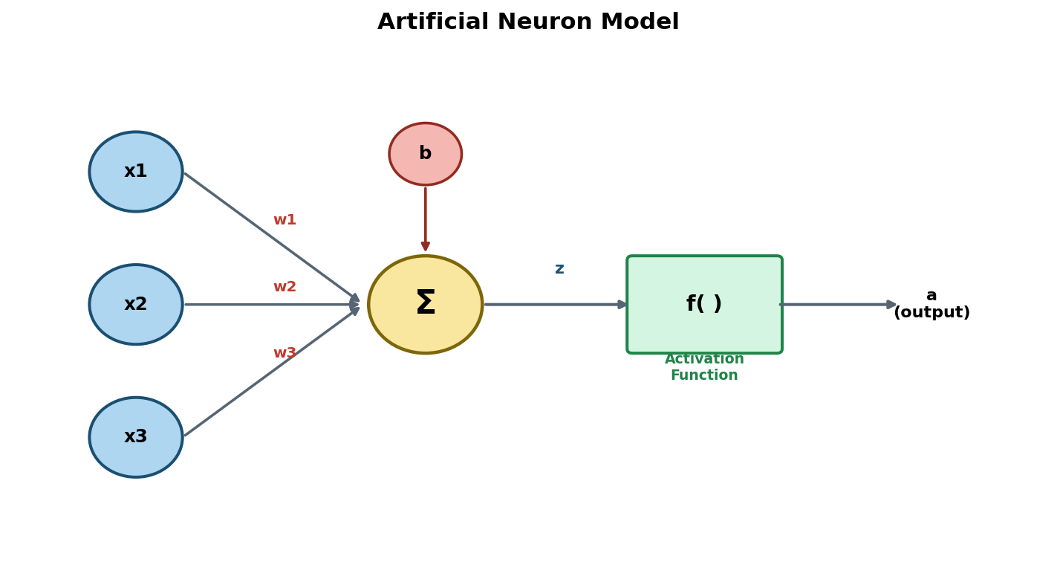
INSPIRATION
From Biology to Mathematics
z = Σ wᵢxᵢ + b
a = f(z)
Inputs (x): feature values Weights (w): learned importance Bias (b): shifts activation threshold f( ): activation function
Artificial Neural Networks
6

Slide 7
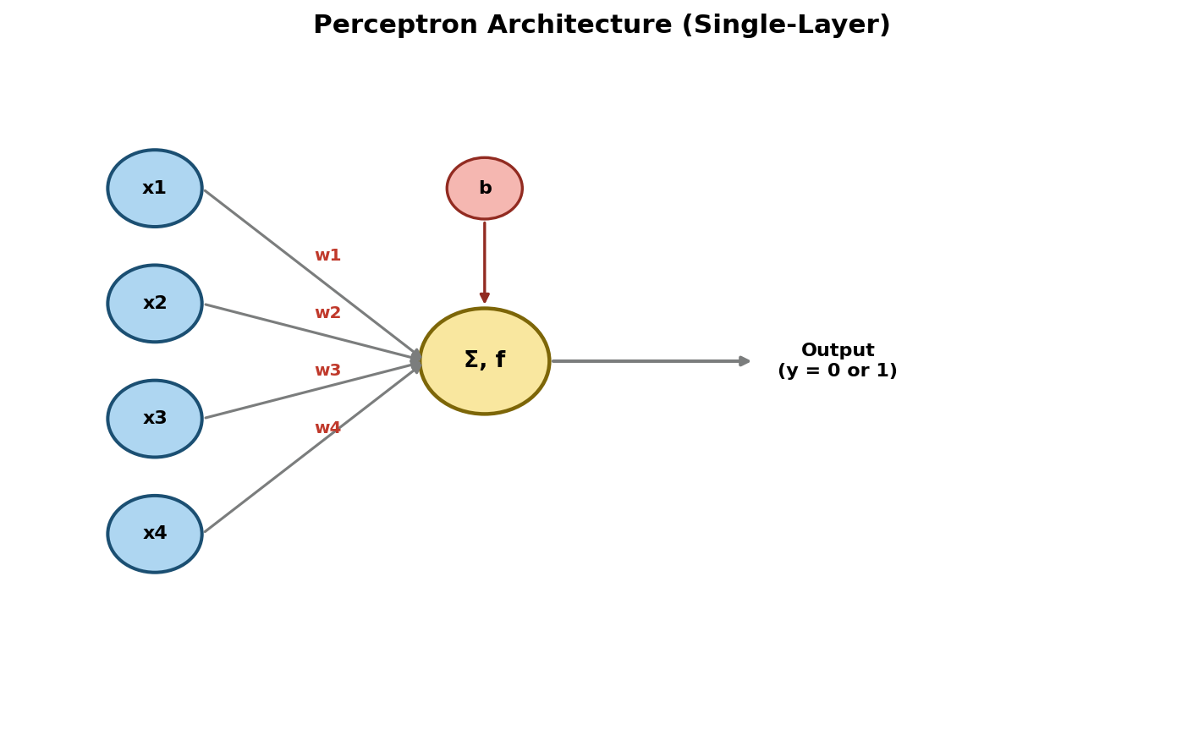
BUILDING BLOCK
The Perceptron (1958)
Inputs (x₁...xₙ)
Weights (w₁...wₙ)
Bias (b)
Summation unit
Step activation → binary output
z = w₁x₁ + w₂x₂ + ... + wₙxₙ + b
y = 1 if z ≥ 0, else 0
Artificial Neural Networks
7

Slide 8
BUILDING BLOCK
Perceptron: Strengths & Limits
Advantages
Limitations
• Simple and computationally inexpensive • Guaranteed convergence on linearly separable data • Foundation for all later neural network models
• Only solves linearly separable problems (fails on XOR) • Hard step function blocks gradient-based learning • Limited representational power vs. multi-layer nets
Artificial Neural Networks
8

Slide 9
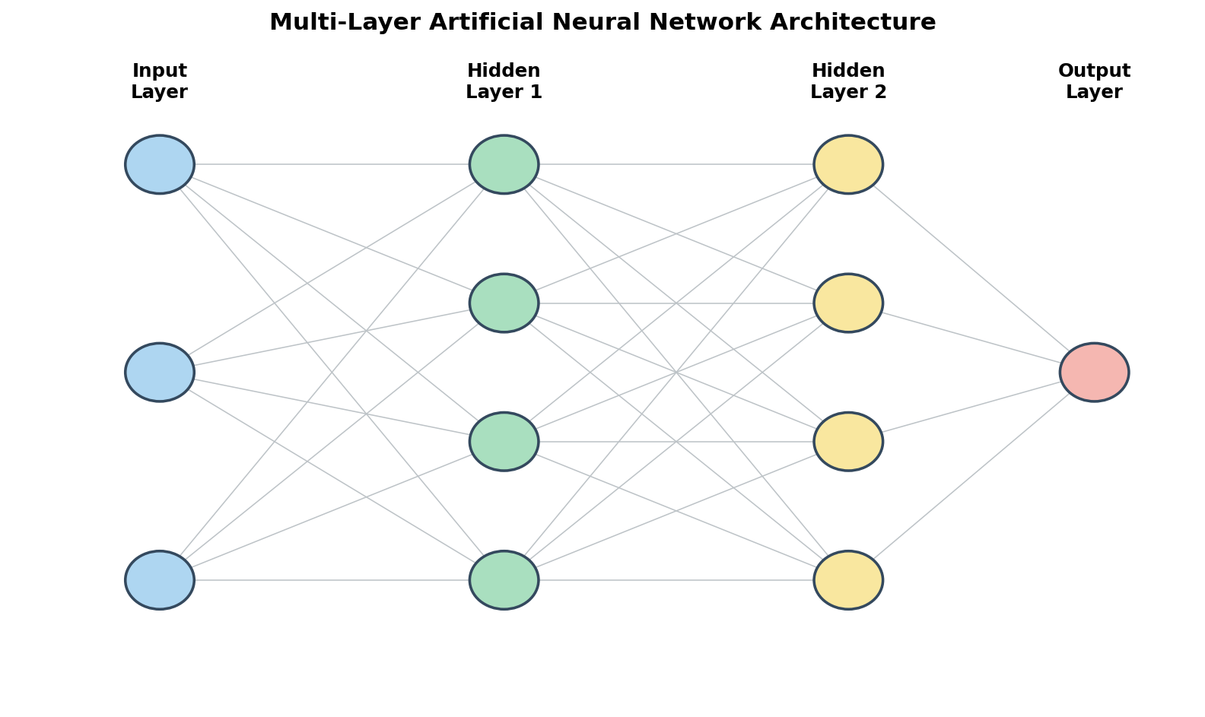
ARCHITECTURE
Multi-Layer ANN Architecture
Input Layer
Hidden Layers
Output Layer
Artificial Neural Networks
9

Slide 10
MATHEMATICS
Mathematical Foundation
Weighted Sum
Activation & Output
z = Σ(i=1→n) wᵢxᵢ + b
a = f(z)
Each input is scaled by its weight; results are summed with a bias term.
Non-linearity is introduced so the network can learn complex, non-linear mappings — without it, stacked layers collapse into one linear function.
Matrix form: Z = W·X + b
Layer form: A[l] = f(W[l]·A[l-1] + b[l])
Artificial Neural Networks
10

Slide 11
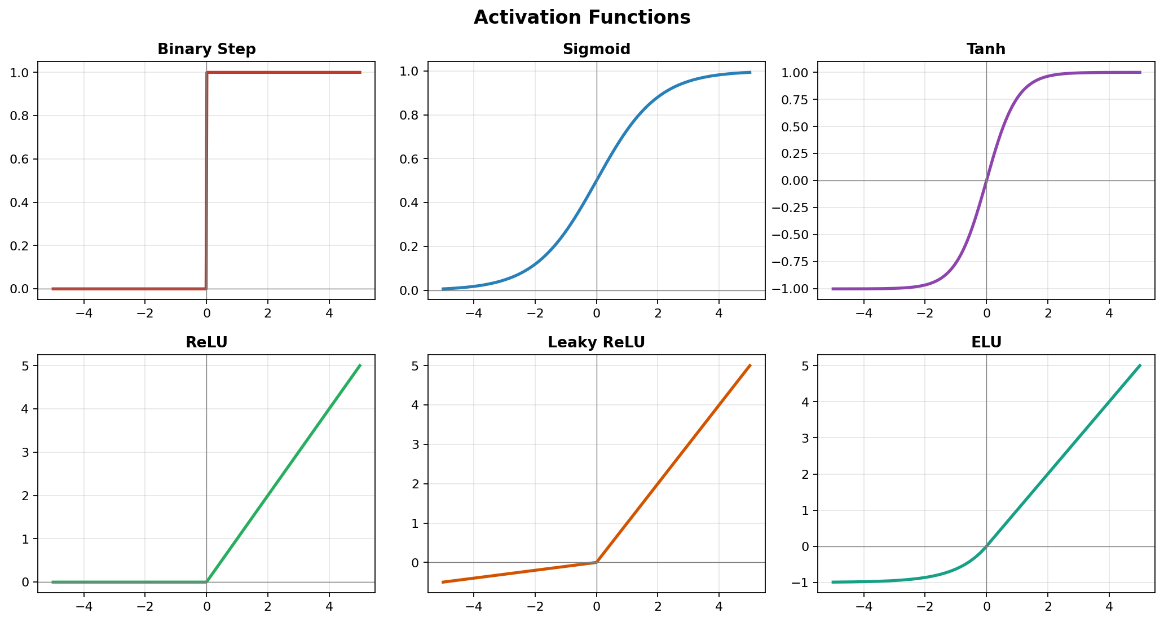
ACTIVATION FUNCTIONS
Why Activation Functions Matter
Artificial Neural Networks
11

Slide 12
ACTIVATION FUNCTIONS
Activation Function Comparison
Function | Range | Key Advantage | Key Disadvantage
Sigmoid | (0, 1) | Smooth, probabilistic | Vanishing gradient
Tanh | (-1, 1) | Zero-centered | Still vanishes at extremes
ReLU | [0, ∞) | Fast, avoids vanishing gradient | 'Dying ReLU' for z < 0
Leaky ReLU | (-∞, ∞) | Fixes dying ReLU | Extra hyperparameter (α)
ELU | (-α, ∞) | Smooth negative values | More costly to compute
Softmax | (0,1), sums to 1 | Multi-class probabilities | Only valid across full vector
Artificial Neural Networks
12

Slide 13
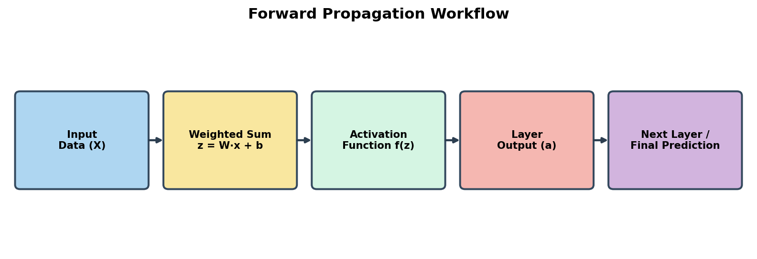
FORWARD PROPAGATION
How Data Flows Through the Network
Input data is multiplied by weights, summed with a bias, passed through an activation function, and forwarded — layer by layer — until the final prediction is produced.
Artificial Neural Networks
13

Slide 14
FORWARD PROPAGATION
Worked Numerical Example
1
Inputs
x1 = 0.6, x2 = 0.9
2
Hidden weighted sum
zh = (0.6·0.5) + (0.9·-0.3) + 0.1 = 0.13
3
Hidden activation (ReLU)
ah = max(0, 0.13) = 0.13
4
Output weighted sum
zo = (0.13·0.8) − 0.05 = 0.054
5
Output activation (Sigmoid)
ao = 1 / (1 + e⁻⁰·⁰⁵⁴) ≈ 0.5135
Final prediction ≈ 0.5135 → classified as the positive class (threshold 0.5)
Artificial Neural Networks
14

Slide 15
TRAINING CONFIGURATION
Key Hyperparameters
Learning Rate
Batch Size
Epochs
Size of each weight-update step during gradient descent
Number of samples processed before one weight update
Number of complete passes through the training data
Hidden Layers
Neurons per Layer
Depth of the network; controls hierarchical feature learning
Width of each layer; controls representational capacity
Artificial Neural Networks
15

Slide 16
ASSESSMENT
Advantages & Limitations of ANN
Advantages
Limitations
• Models complex, non-linear relationships • Generalizes well with sufficient data • Flexible across vision, language, tabular, time-series • Scales with more data and compute • Learns features automatically
• Needs large amounts of labeled data • Computationally expensive to train • Prone to overfitting • Largely a 'black box' — hard to interpret • Sensitive to hyperparameters & initialization
Artificial Neural Networks
16

Slide 17
REAL-WORLD IMPACT
Where ANN Is Used Today
Image Classification
Healthcare
Finance
Identifying objects, faces, and scenes
Diagnosis support & outcome prediction
Credit scoring & algorithmic trading
Speech Recognition
Recommendations
Fraud Detection
Converting speech into text
Personalized content & product suggestions
Flagging anomalous transactions in real time
Forecasting
Predicting demand, prices, and trends over time
Artificial Neural Networks
17

Slide 18
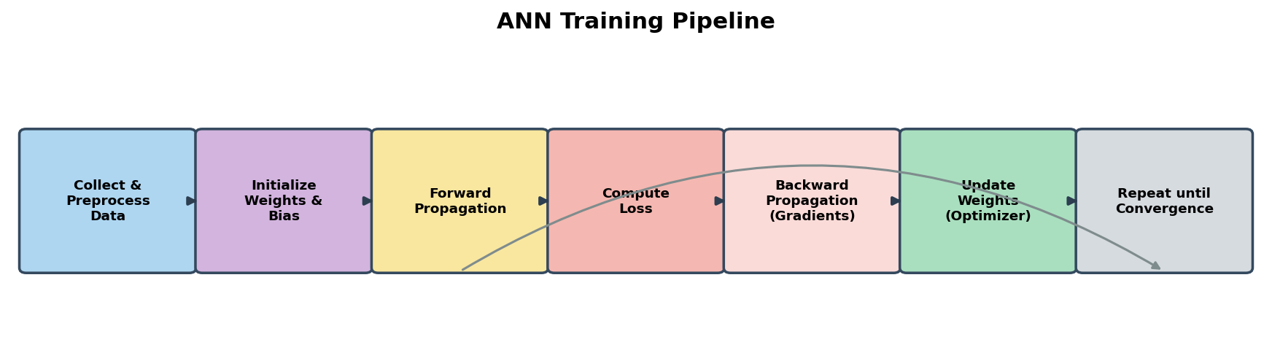
THE BIGGER PICTURE
The ANN Training Pipeline
Artificial Neural Networks
18

Slide 19
HANDS-ON WORK
What's Inside the Notebook
Task 1–2: Activation functions implemented & plotted from scratch (NumPy)
Task 3: A single artificial neuron — weighted sum & activation
Task 4: Full forward propagation, 2→3→1 network (NumPy)
Task 5: Equivalent network rebuilt in TensorFlow/Keras — outputs verified to match
Task 6: Overlayed comparison of activation functions
Task 7 (Bonus): End-to-end ANN trained on the Breast Cancer Wisconsin dataset, with loss/accuracy curves and a confusion matrix
Artificial Neural Networks
19

Slide 20
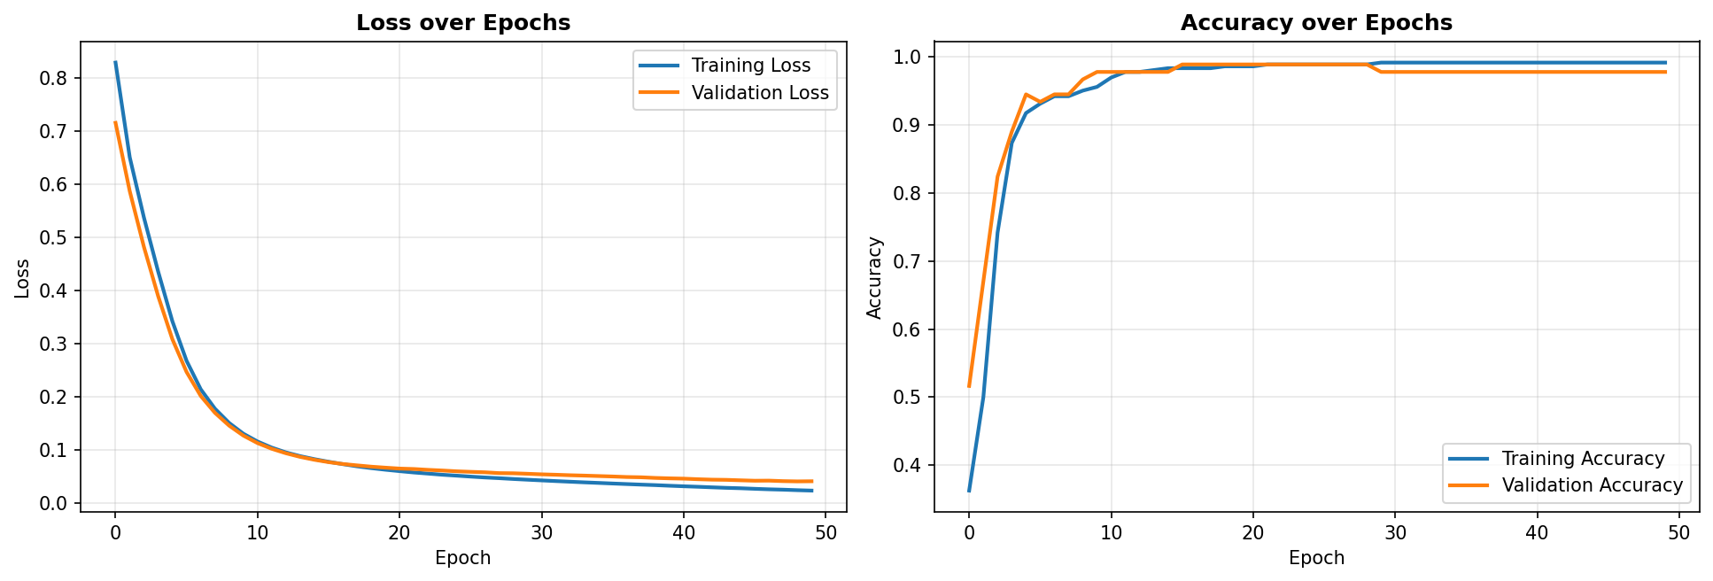
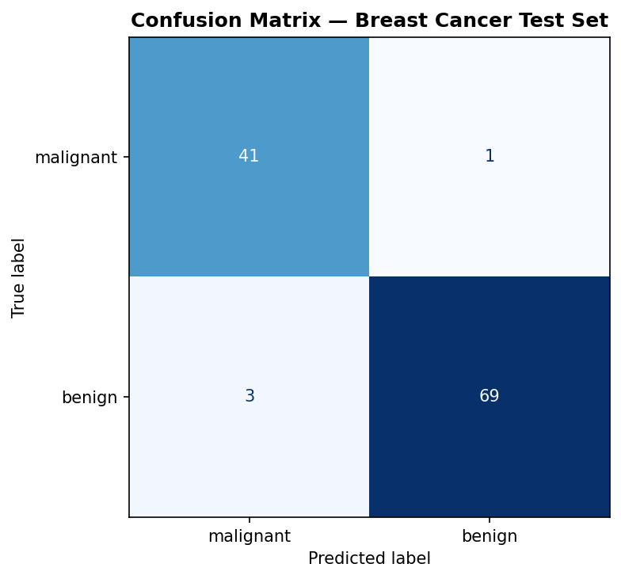
RESULTS SNAPSHOT
Bonus Task: Breast Cancer Classifier
A 30 → 16 → 8 → 1 Keras ANN (ReLU + Sigmoid) trained on 30 numeric tumor features converges within ~50 epochs, with training and validation curves tracking closely.
Artificial Neural Networks
20

Slide 21
Thank you
Artificial Neural Networks
22

